Slide 1
Measurement
EQ: How do we find the missing side length?

Slide 2
Perimeter
Perimeter is the total length around the outside of a shape.
If we know some of the measurements, we can work out the rest using reasoning.

Slide 3
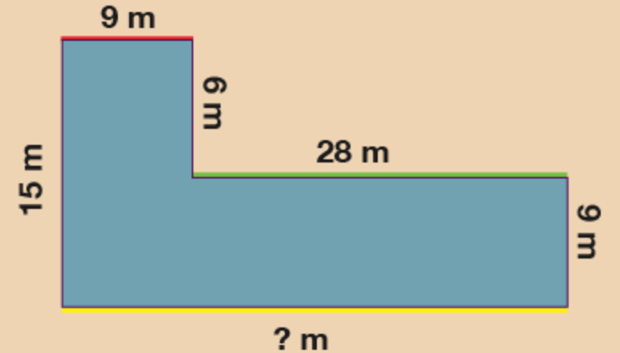
24
7
30
Date
Units of length
EQ – How do I find the missing side length?
9 + 28 = 37
? = 37m
5

Slide 4
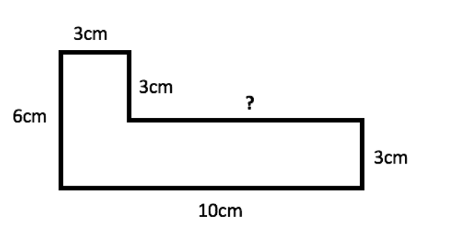
24
7
30
Date
Units of length
EQ – How do I find the missing side length?
?
4cm
12cm
? + 4 = 6
? = 2cm
? + 3 = 12
? = 9cm
5

Slide 5
The tricky part
Make sure all of the units are the same before you add up!!!
Have a go at the quick sheet.

